Slide 1
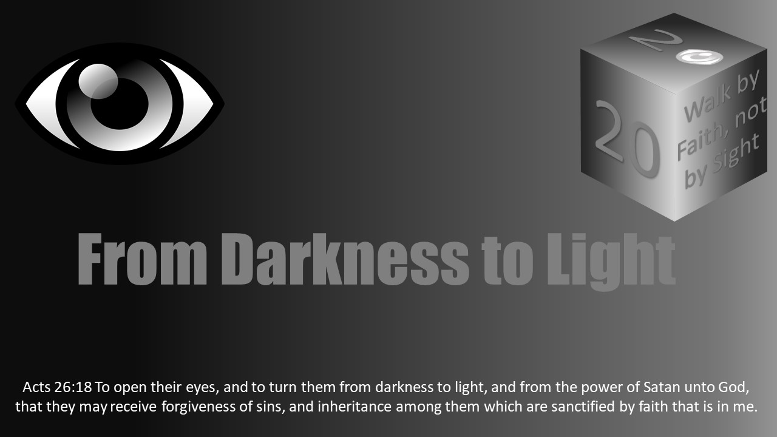


Slide 2
Darkness Lesson 14 - Dealing With Racism and Prejudice

Slide 3
Introduction
“Why do we even have to talk about racism? Wouldn’t it better if we just didn’t say anything?”
Racism is a problem that continues to exist.
Racism is still a problem
Plenty of people who are talking about racism. But not enough are going to the source where one can find the solution: God’s word.

Slide 4
Introduction
“All Scripture is inspired by God and profitable for teaching, for reproof, for correction, for training in righteousness; so that the man of God may be adequate, equipped for every good work” (2 Timothy 3:16-17).
If anyone should be talking about this subject, it should be God’s people! It is a topic we can not shy away from.
We will have to be bold and courageous.
We will have to trust in God and His word.
Racism has been used by used by Satan to distort our perception of reality too long.
We must use God's word and the lens of faith to see this as God has instructed.

Slide 5
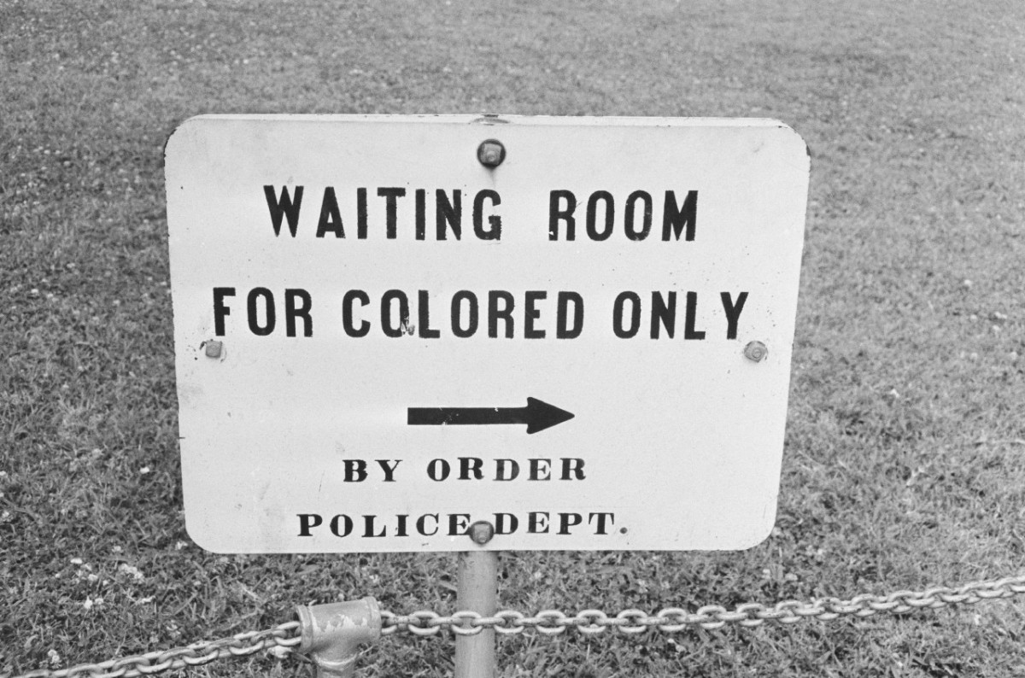
DISCUSSION
What stood out to you in this story from the brother who grew up in Louisiana?

Slide 6
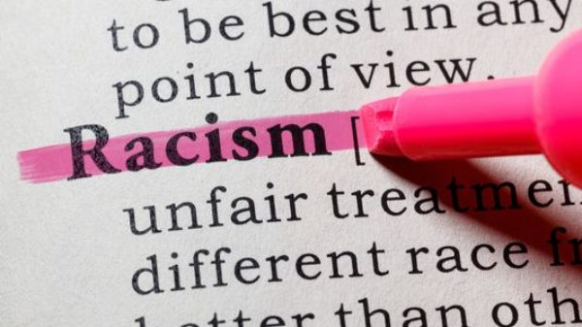
What is the problem? Defining racism
Racism can be defined according to dictionary.com as:
“A belief or doctrine that inherent differences among the various human racial groups determine cultural or individual achievement, usually involving the idea that one’s own race is superior and has the right to dominate others or that a particular racial group is inferior to the others.”
Another definition is “hatred or intolerance of another race or other races.”

Slide 7
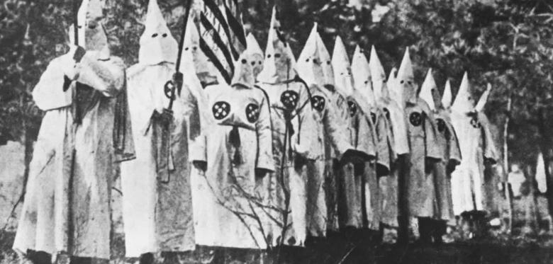
“We all stereotype, based on ethnic groups, sexes, races, or other groupings. When those statements are based on skin color, are derogatory, and extreme, it could be called 'racism. When not extreme, I would call it 'implicit bias.' There is white-black bias, black-Hispanic bias, urban-rural bias, male-female bias, northern-southern bias. Implicit bias affects our actions, words, and feelings, though we are often unaware of it. When I see race-based implicit bias acted out, I see it among my white colleagues. It usually involves white people assuming less of black people. In these cases, whites might see blacks as prone to crime and teenage pregnancy, poorly educated, and athletic instead of academic. This bias, completely unintentional, is in our brotherhood at various degrees. It is caused by historical events and statistical data. From my experience, biases are less frequent in the congregation than in the world, assuming the congregation is strong. What is a concern to me is the lack of understanding of life for the black person versus the white person. Even lack of interest. Whites in the brotherhood do not know how to sympathize with their black brethren. They believe the mistreatment of blacks is similar to mistreatment of whites. They deny the concepts of white privilege and micro aggressions. Instead of investigating these concepts, many white Christians become angry at their mention and consider such concepts as part of the liberal agenda. In my experience, the lack of understanding, listening, and sympathy is commonplace among whites in the church. Even among elders. Very common and heartbreaking. When blacks protest, whites believe they are overreacting (unless the KKK is involved or a Rodney King type of video is provided).” - Craig Roberts

Slide 8
Discussion
How familiar are you with the idea of implicit bias? What about micro aggression? Think about if you have ever struggled with biases toward certain people.

Slide 9
Racism is a heart problem.
It is learned behavior.
Children don’t have this problem.
Watch how they all play together.
It’s a potential problem for everyone.
Racism is sinful!

Slide 10
How does this help us understand how racism is sinful?
Genesis 1:26: “Then God said, “Let Us make man in Our image, according to Our likeness; and let them rule over the fish of the sea and over the birds of the sky and over the cattle and over all the earth, and over every creeping thing that creeps on the earth.”

Slide 11
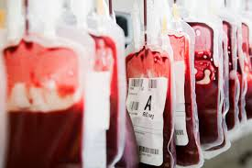
How does this help us understand how racism is sinful?
Genesis 9:6: “Whoever sheds man’s blood, By man his blood shall be shed, For in the image of God He made man.”

Slide 12
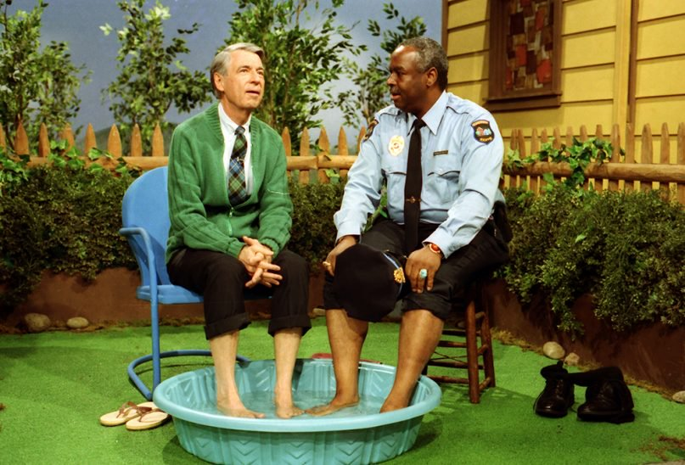
How does this help us understand how racism is sinful?
Luke 10:27-29: And he answered, “You shall love the Lord your God with all your heart, and with all your soul, and with all your strength, and with all your mind; and your neighbor as yourself.” And He said to him, “You have answered correctly; do this and you will live.” But wishing to justify himself, he said to Jesus, “And who is my neighbor?”

Slide 13
How does this help us understand how racism is sinful?
Galatians 3:28: “There is neither Jew nor Greek, there is neither slave nor free man, there is neither male nor female; for you are all one in Christ Jesus.”

Slide 14
How does this help us understand how racism is sinful?
Matthew 7:12: “In everything, therefore, treat people the same way you want them to treat you, for this is the Law and the Prophets.”
Racism is wrong. It is sinful. Let’s avoid it at all costs

Slide 15
What is the solution?
The solution for this terrible heart condition is Jesus Christ.
God has always loved all men.

Slide 16
What is the solution? discussion
How did Jonah’s view of the people in Nineveh differ from how God viewed them?

Slide 17

What is the solution?
God loves all men. Jesus loves all men.
John 3:16 reads, “For God so loved the world, that He gave His only begotten Son, that whoever believes in Him shall not perish, but have eternal life.”
When one understands that Jesus died to deliver us from our sins, it should change the way we view everyone.
God the Father loved the world so much He sent His Son to die.
Jesus is the one that can change the hearts of men.
Mark 7:21-23 teaches, “For from within, out of the heart of men, proceed the evil thoughts, fornications, thefts, murders, adulteries, deeds of coveting and wickedness, as well as deceit, sensuality, envy, slander, pride and foolishness. All these evil things proceed from within and defile the man.”

Slide 18
What is the solution?
Jesus was the solution that brought both Jews and Gentiles into one body.
Ephesians 2:11-18 “Therefore remember that formerly you, the Gentiles in the flesh, who are called 'Uncircumcision' by the so-called 'Circumcision,' which is performed in the flesh by human hands— remember that you were at that time separate from Christ, excluded from the commonwealth of Israel, and strangers to the covenants of promise, having no hope and without God in the world. But now in Christ Jesus you who formerly were far off have been brought near by the blood of Christ. For He Himself is our peace, who made both groups into one and broke down the barrier of the dividing wall, by abolishing in His flesh the enmity, which is the Law of commandments contained in ordinances, so that in Himself He might make the two into one new man, thus establishing peace, and might reconcile them both in one body to God through the cross, by it having put to death the enmity. And He came and preached peace to you who were far away, and peace to those who were near; for through Him we both have our access in one Spirit to the Father.”

Slide 19
What is the solution?
While Jesus is the solution, it took a lot of time for Jews and Gentiles to come together. They did have challenges and even setbacks. They did. It took time for their hearts to change.
One of the best examples of this was with the apostle Peter.
Acts 10:28 “And he said to them, “You yourselves know how unlawful it is for a man who is a Jew to associate with a foreigner or to visit him; and yet God has shown me that I should not call any man unholy or unclean.”

Slide 20
What is the solution?
Acts 11:1-3 Now the apostles and the brethren who were throughout Judea heard that the Gentiles also had received the word of God. And when Peter came up to Jerusalem those who were circumcised took issue with him, saying, “You went to uncircumcised men and ate with them.”
It took a lot for Peter to go to the house of Cornelius. Even when he got to his house, it was uncomfortable for him. But in the process of time, he would learn that “God is not one to show partiality.”

Slide 21
What is the solution?
Peter and others in the first century help us to see that it is possible for hearts to change.
Acts 11:18 When they heard this, they quieted down and glorified God, saying, ‘Well then, God has granted to the Gentiles also the repentance that leads to life.’” If they were able to change, people can change today.

Slide 22
How should we respond?
We know all of the right things to say.
We know racism is sinful and that Jesus is the solution.
Yet, if not careful, racism or implicit bias can still get the best of us.
There are some things that we all need to consider and do.
They are not always easy, but should still be done.

Slide 23
How should we respond? EXAMINE YOUR HEART
Acts 10:34 teaches, “Opening his mouth, Peter said: ‘I most certainly understand now that God is not one to show partiality.’”
As Christians, we should always be doing this. We need to take some time and really consider if we have some blind spots that have been causing us to treat or view our brethren and people in the world the wrong way.

Slide 24
How should we respond? EXAMINE YOUR HEART
Think about the following:
How we talk about other people: Are we using inappropriate speech in our homes as we talk about others of different races? If so, why? We should repent if so.
When someone brings up an issue about, am I truly listening or am I preparing what I am going to say as they speak?
Am I lefting or righting the issue (MSNBC vs. Foxnews) when it comes to race? Or am I really trying to look at it and understand what others are going through with the proper vision?
When I hear or see others acting or speaking in a sinful way, am I too afraid to say anything?
Have I allowed past experiences to get in the way of me being sympathetic towards others now?
If you see a black man with a white woman, or a white man with a black woman, does that make you feel uncomfortable? If so, ask yourself why? It may help uncover some things you have not considered.

Slide 25

How should we respond? Be a pioneer
Acts 9:26-27 reads, “When he came to Jerusalem, he was trying to associate with the disciples; but they were all afraid of him, not believing that he was a disciple. But Barnabas took hold of him and brought him to the apostles and described to them how he had seen the Lord on the road, and that He had talked to him, and how at Damascus he had spoken out boldly in the name of Jesus.”

Slide 26
How should we respond? Be a pioneer
I love the phrase, “Be a pioneer.” Be like Barnabas. Remember what he did? When the saints were afraid of Paul, it was Barnabas who helped bridge the gap. It is a good thing that he did! He was bold and courageous. This is the mindset we must have. Be a person that unites people. Be a person that fixes a situation. When it comes to race, there are so many things we can do.
One could start a study in their home discussing this very issue. I think one of the best things to do is for us to open up our homes more.
Acts 10:48 illustrates, “And he ordered them to be baptized in the name of Jesus Christ. Then they asked him to stay on for a few days.”

Slide 27
How should we respond? Be a pioneer
Remember when Peter and the other Jews stayed at the house of Cornelius? Can you imagine all of them sitting down for breakfast the next day?
Have some genuine conversations about race with others. Talk about what terms may be appropriate or not appropriate to use. Truly seek to understand the struggles and challenges others have been through.
Learn about different experiences those in your congregation may have experienced in the past and in the present.
I believe too many brethren will vent and try to have a conversation on Facebook about this topic. I do not believe that will work. It often creates more problems.
Less talking via social media and more face to face conversations are needed.
This will require courage, time, and effort. Make it a priority. The more we talk about it and focus on Jesus, the more things will improve.
Teach a class on this subject. Preach a sermon on it. Be bold!

Slide 28
How should we respond? Don’t be a sellout
Ephesians 2:14-18 reads, “For He Himself is our peace, who made both groups into one and broke down the barrier of the dividing wall, by abolishing in His flesh the enmity, which is the Law of commandments contained in ordinances, so that in Himself He might make the two into one new man, thus establishing peace, and might reconcile them both in one body to God through the cross, by it having put to death the enmity. And He came and preached peace to you who were far away, and peace to those who were near; for through Him we both have our access in one Spirit to the Father.”

Slide 29
How should we respond? Don’t be a sellout
What I mean by don't be a sellout is this: Don’t sell out your faith in Jesus or your fellowship with brethren because of your families, your race, or your political views.
We are in Christ. That’s a really big deal! Do not take it lightly.

Slide 30
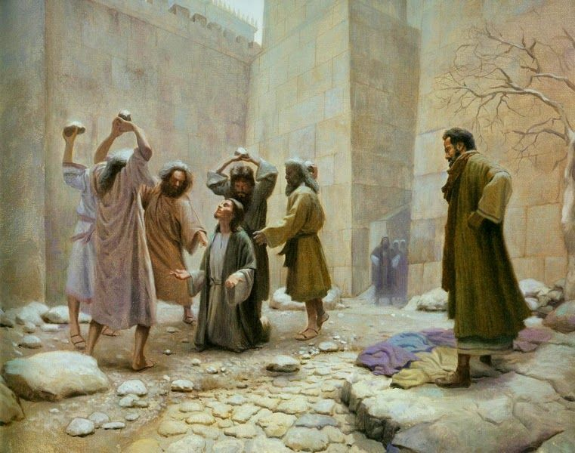
How should we respond? Share the gospel
Acts 8:1-4 reads “Saul was in hearty agreement with putting him to death. And on that day a great persecution began against the church in Jerusalem, and they were all scattered throughout the regions of Judea and Samaria, except the apostles. Some devout men buried Stephen, and made loud lamentation over him. But Saul began ravaging the church, entering house after house, and dragging off men and women, he would put them in prison. Therefore, those who had been scattered went about preaching the word."

Slide 31
How should we respond? Share the gospel
Do you ever find yourself hesitating inviting someone to services or to a Bible study who may not look like you? If so, why do you think that is? What can you do to overcome it?
Do you ever find yourself hesitating inviting someone to services or to a Bible study who may not look like you? If so, why do you think that is? What can you do to overcome it?

Slide 32
How should we respond? Be patient and forgive
Colossians 3:12-13 teaches, “So, as those who have been chosen of God, holy and beloved, put on a heart of compassion, kindness, humility, gentleness and patience; bearing with one another, and forgiving each other, whoever has a complaint against anyone; just as the Lord forgave you, so also should you.”

Slide 33
How should we respond? Be patient and forgive
While the apostle Peter experienced so much when he went to the house of Cornelius, he still had room to grow. He was a hypocrite at times.
Galatians 2:11-15 records, “But when Cephas came to Antioch, I opposed him to his face, because he stood condemned. For prior to the coming of certain men from James, he used to eat with the Gentiles; but when they came, he began to withdraw and hold himself aloof, fearing the party of the circumcision. The rest of the Jews joined him in hypocrisy, with the result that even Barnabas was carried away by their hypocrisy. But when I saw that they were not straightforward about the truth of the gospel, I said to Cephas in the presence of all, “If you, being a Jew, live like the Gentiles and not like the Jews, how is it that you compel the Gentiles to live like Jews?”

Slide 34
How should we respond? Be patient and forgive
The brethren needed to be patient with Peter. It did not mean that they tolerated his sinful behavior. What we see is that Paul corrected Peter.
The same will have to happen to us and others. We are all on a journey. We all have different pasts.
There will be times when someone may say or act in a manner that is not Christ-like. During those moments, we will have to have some difficult conversations and be willing to forgive.
Esau was ready to kill his brother Jacob because of missing out on his birthright and blessing from his father Isaac. Esau came to forgive his brother.
What’s interesting about all of this is that the descendants of Esau did not respond in the same manner. They were filled with bitterness toward Israel. I think this can and still does happen.

Slide 35
How should we respond? Be patient and forgive
Has someone in the past hurt you? Has someone treated you in an ungodly way because of your race? How did you handle that situation?

Slide 36
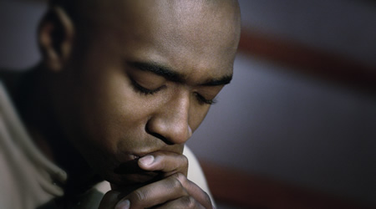
How should we respond? Pray for all
1 Timothy 2:1-4 teaches, “First of all, then, I urge that entreaties and prayers, petitions and thanksgivings, be made on behalf of all men, for kings and all who are in authority, so that we may lead a tranquil and quiet life in all godliness and dignity. This is good and acceptable in the sight of God our Savior, who desires all men to be saved and to come to the knowledge of the truth.”

Slide 37
How should we respond? Pray for all
We do not hate those who are racist, but rather we pray for their souls. They too were created in the image of God. We seek to pray, teach, and provide a godly example for them.
Who might you be able to pray for who may be struggling with this issue? Who might you be able to pray for who has been hurt by someone else who was racist?

Slide 38
How should we respond? Remember vengeance belongs to god
Romans 12:17 instructs, “Never pay back evil for evil to anyone. Respect what is right in the sight of all men. If possible, so far as it depends on you, be at peace with all men. Never take your own revenge, beloved, but leave room for the wrath of God, for it is written, “Vengeance is Mine, I will repay,” says the Lord. “But if your enemy is hungry, feed him, and if he is thirsty, give him a drink; for in so doing you will heap burning coals on his head.” Do not be overcome by evil, but overcome evil with good.”
God is the righteous judge. We do not repay evil with evil. This can be difficult. We seek rather to be the lights in this world.

Slide 39
How should we respond? Respond with love
John 3:16 teaches, “For God so loved the world, that He gave His only begotten Son, that whoever believes in Him shall not perish, but have eternal life.”
1 Peter 2:17 commands, “Honor all people, love the brotherhood, fear God, honor the king.”
Let us view people the proper way. Let us love them just as Christ has loved us.
As we approach this subject, let us do it with truth, compassion, and with love.
As we view our brethren, let us think the best of them.
God required the most of Himself, and He demonstrated agape love. He loved us when we were unlovable. We must do the same.

Slide 40
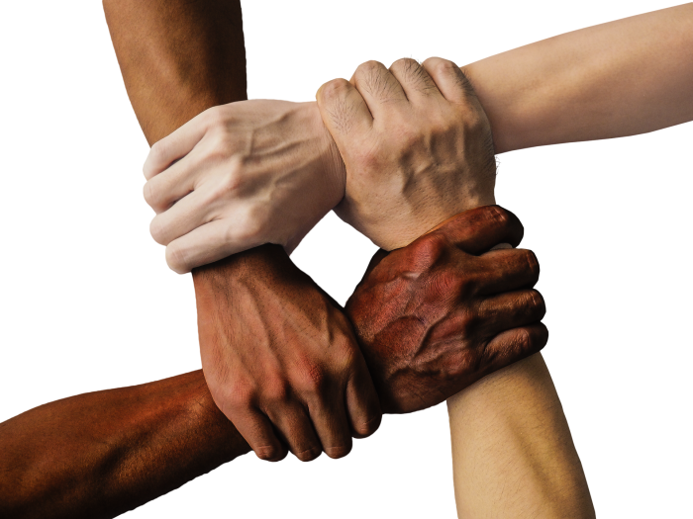
How should we respond? Respond with love
As the people of God, let us shine our lights.
Let us show people what God the Father and His Son have done not just for us, but for the entire world.
We have the gospel.
Let us share it with as many people as possible.
When we do, hearts will be changed for the better, and the devil will be defeated

